Slide 1
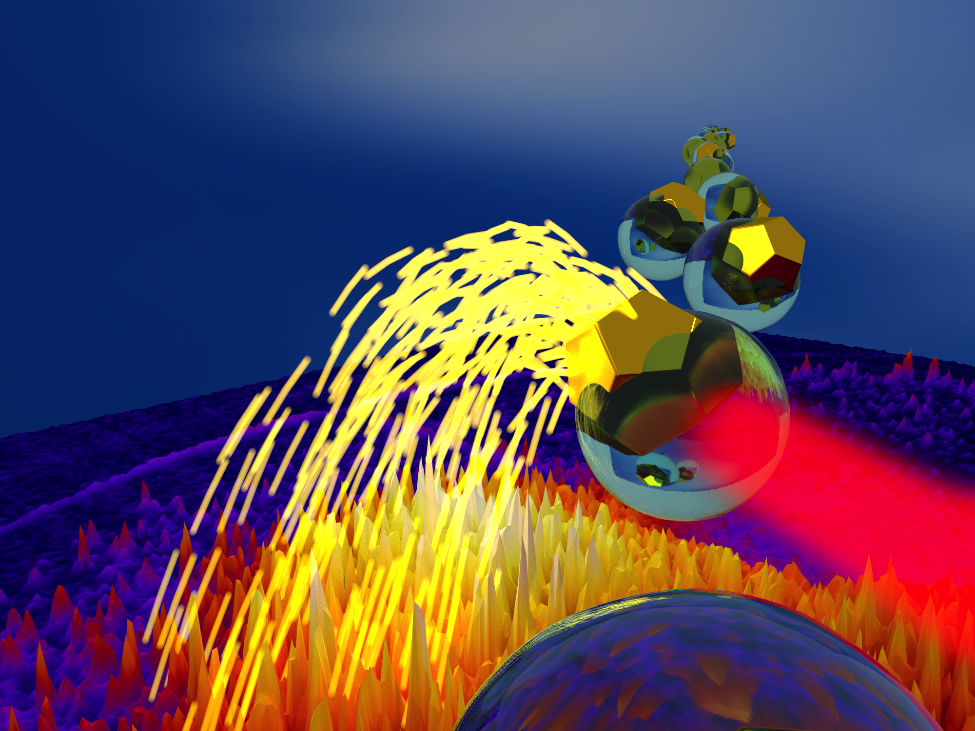

Nanoparticles and nanoplasmas in femtosecond laser fields
Daniel Hickstein
Kapteyn–Murnane Group
JILA – University of Colorado
Boulder, CO, USA
Notes:
Good afternoon, and thank you all for coming to my talk. My name is Daniel Hickstein and I’m from the Kapteyn–Murnane research group at the University of Colorado in Boulder, Colorado. In this talk, I’m going present some recent (very exciting!) results about how nanoparticles and nanoplasmas respond to femtosecond laser fields.
This might look like just a pretty picture, but actually this shows the basic experimental concept. In brief, the experiment consists of nanoparticles flying through a high-vacuum chamber. We then hit a single nanoparticle with a femtosecond laser and ions are ejected. These ions are collected on a velocity imaging spectrometer, and carry information about the nanoparticle or nanoplasma.

Slide 2
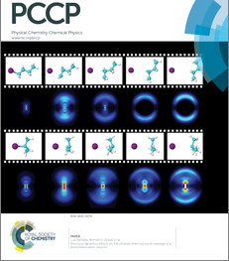
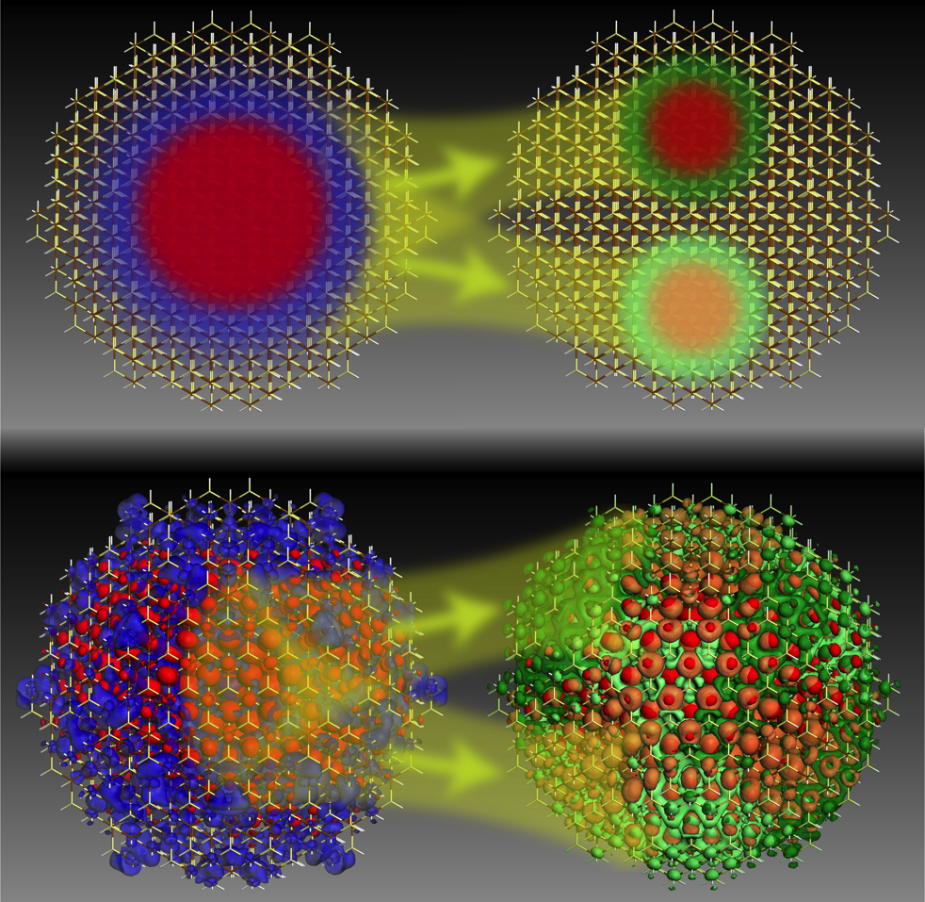
Motivation
Nanoparticle structure and dynamics
Mark Lusk, Colorado School of Mines
Electronic structure of
quantum dots (semiconductor nanocrystals)
Velocity Map Imaging Spectroscopy (VMI)
Notes:
So how did we get involved in this difficult and very messy business of putting nanoparticles into our VMI spectrometer?
Here I’m showing two journal covers. This cover on the left is from the Zewail group and is a nice demonstration of how VMI images like these can provide beautifully detailed information about the electronic structure of a molecule in the gas phase. With these cartoons, they are showing how the experimental images at various time delays can be stitched together to provide a femtosecond movie of a chemical reaction.
On the right I’m showing an ACS nano cover from the Lusk group that shows a calculation of excitonic wavefunctions in quantum dots. Our overarching goal is to use velocity map imaging to try to detained images and movies of nanomaterials just like it has done for atoms and molecules in the gas phase.

Slide 3
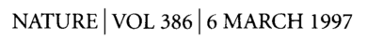
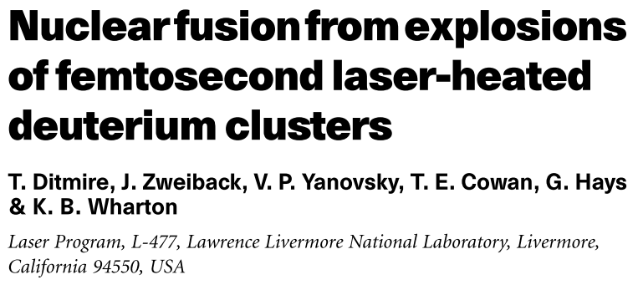
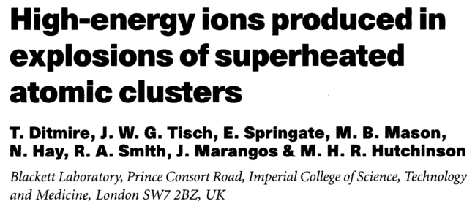
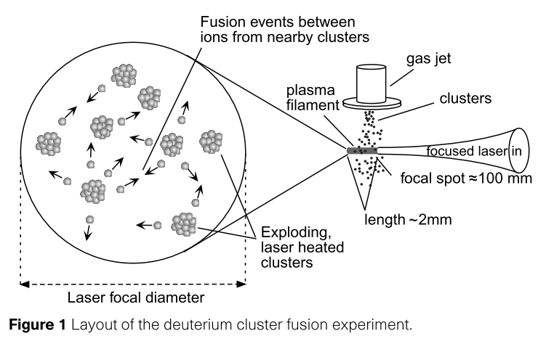
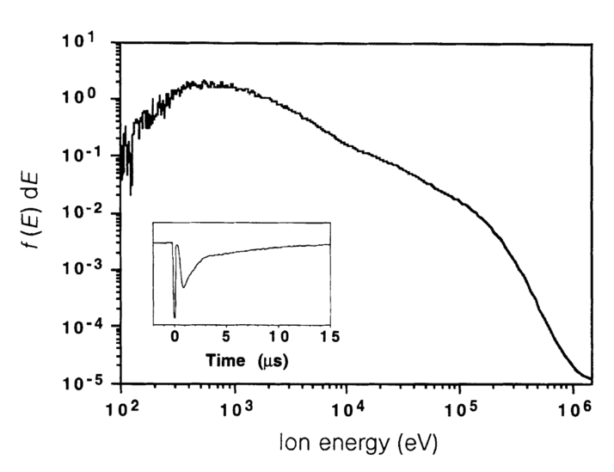
Motivation: nanoplasmas
Great light absorbers
2x10¹⁶ W/cm²
2x10¹⁶ W/cm²
Notes:
In the process of trying to image the electronic structure of nanomaterials, we realized that VMI is also an excellent way to investigate a much higher intensity regime, where nanoparticles are rapidly converted into nanoplasmas.
I think that the word “nanopalsma” is really cool. But, if that is not enough to get you excited, let me get you interested by saying that nanoplasmas have an unusual ability to absorb large amounts of laser energy into a small volume, and, in-so-doing, produce very high energy physics with table-top scale lasers. For example, I show two articles here, one where nanoplasmas were used to generate ions up to 1 Mega-electron-volt, and another where nanoplasmas were used to achieve nuclear fusion. Both of these studies were completed at intensities accessible to current tabletop scale lasers. So, that’s pretty cool, right? Nothing? You are a tough audience. Nuclear fusion? Nothing?

Slide 4


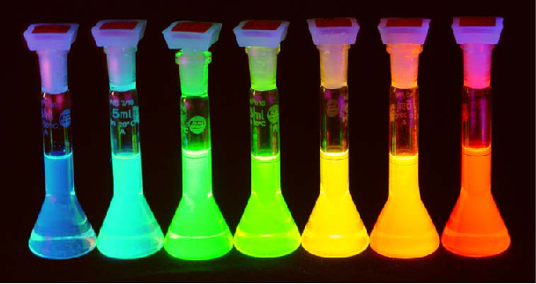
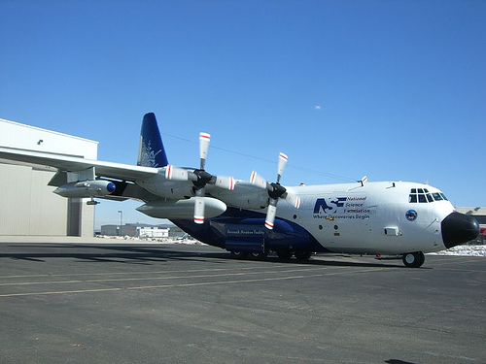
Nanoparticles in vacuum?
University of Colorado Chemistry Department
Brett Palm
Jose Jimenez
Notes:
As most of you know, nanoparticles are typically found imbedded in bulk material, attached to a surface, or, most commonly, swimming in a large container of solvent. So, how did we go about getting them into our ultrahigh vacuum chamber? Well, we were lucky enough to be located just down the block from the Jose Jimenez group at the University of Colorado Chemistry Department. Jose and his lab spend their time flying around in airplanes sucking atmospheric dust into their mass spectrometers. So, these people are truly professionals at getting nanoparticles into vacuum chambers. They were nice enough to show us the equipment that they use and how it works. So, as soon as their back was turned, we “borrowed” that equipment and attached it to our spectrometer.

Slide 5
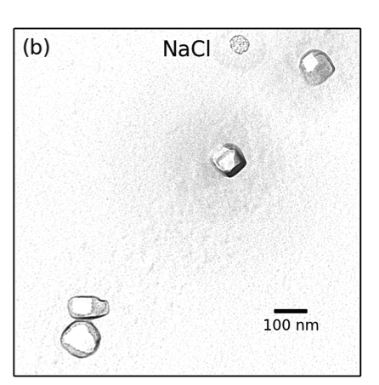
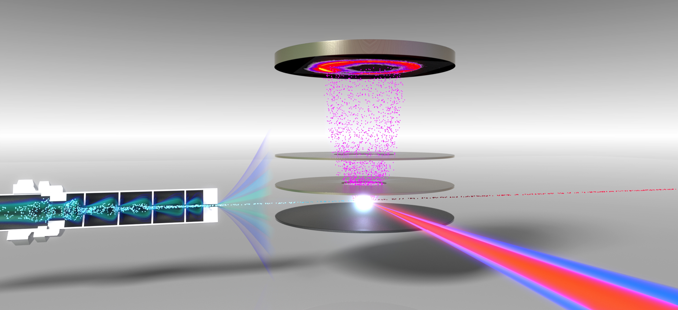
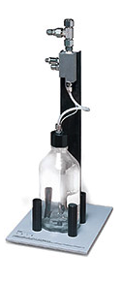
Experiment
VMI spectrometer + aerodynamic lens
Detector
Positive ions
Aerodynamic lens
VMI Electrodes
400 nm and 800 nm
laser pulses
(40 fs, 1 kHz)
Nanoparticle beam
Plasma explosion from single nanoparticle
atomizer
Notes:
So, this figure shows our VMI spectrometer, which we have modified by attaching a nanoparticle source. The source consists of a compressed gas atomizer and an aerodynamic lens. We start with 1 liter bottle containing either colloidal nanoparticles or simply a salt solution. The atomizer produces a fine mist of 1 micron droplets which evaporate to leave behind nanoparticles with diameters of about 100 nm. These particles consist of either aggregates of nanoparticles or single crystals of salt. The nanoparticle aerosol then passes through the aerodynamic lens, which forms a collimated beam of nanoparticles while leaving the gas divergent. The nanoparticle beam is then crossed with a femtosecond laser operating at 1 kHz. The positive ions that are released are collected by a velocity-map-imaging spectrometer.
The most interesting part of this experiment is that we can control the number of nanoparticles in the interaction region simply by changing the spot size of the laser. In the experiments that I will talk about today, we use a very small laser which allows us to probe single nanoparticles.

Slide 6
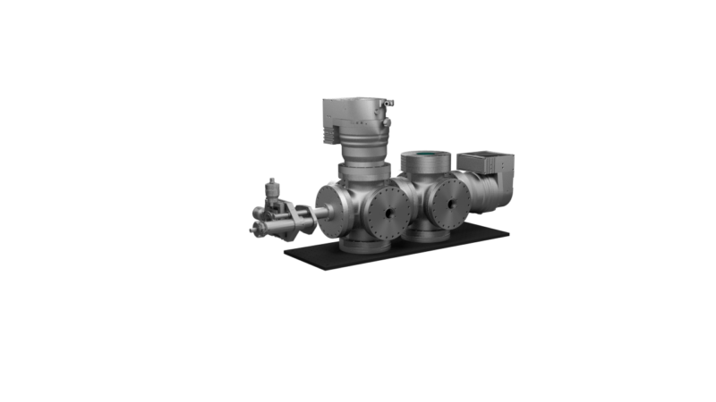
Apparatus
Notes:
This is what the apparatus looks like from the outside. It is about 1 meter long and consists of two differentially pumped vacuum chambers. Since this is a special occasion, let’s cut the chamber is half and see what is happening inside. As you can see, the nanoparticles emerge from the aerodynamic lens and pass into the VMI spectrometer. The laser creates a plasma from a single nanoparticle and the positive ions are pushed towards the detector.

Slide 7
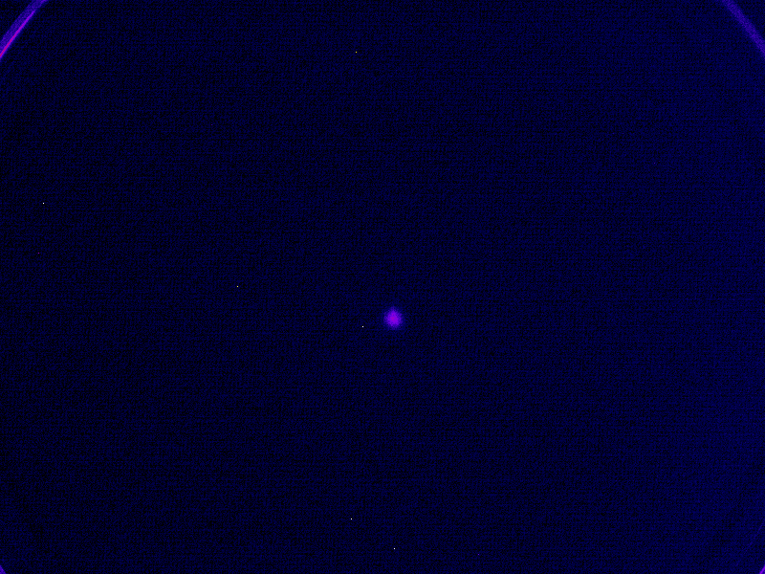
Observation of nanoplasma explosions
Laser polarization
Laser propagation
Notes:
Here is a slightly more colorful view of what the raw data looks like on the detector. You can see sudden flashes that contain on the order of 10,000 or more ions. These flashes correspond to the conversion of a nanoparticle into a nanoplasma, which rapidly expands and showers the detector with positive ions.
You will notice that there is a lot of variability of the photoion yield and the shape of the photoion angular distribution. This is due to two reasons: First, the nanoparticles can sample a wide range of intensities in the laser focus. And Second, the nanoparticles have a distribution of shapes and sizes and this influences the photoion distribution, as I will cover in the second part of this talk.

Slide 8
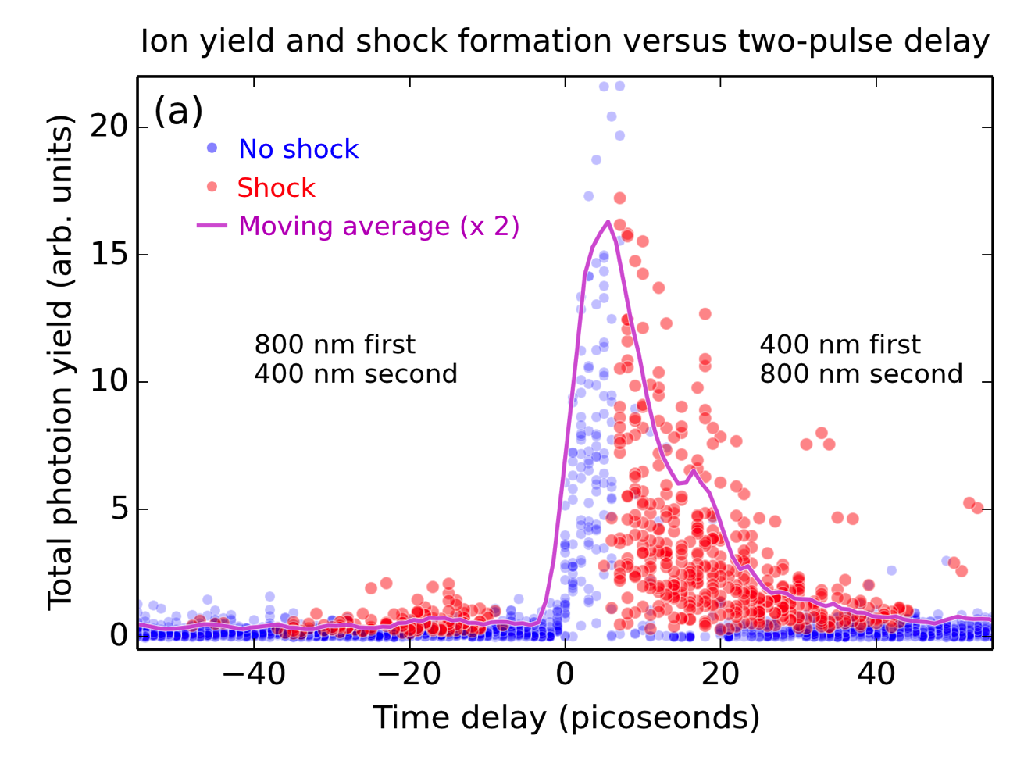

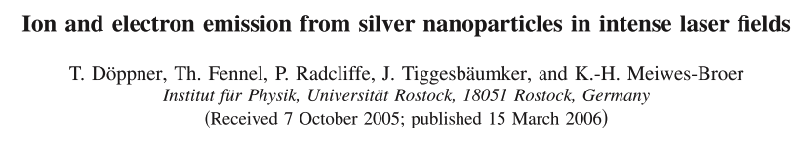
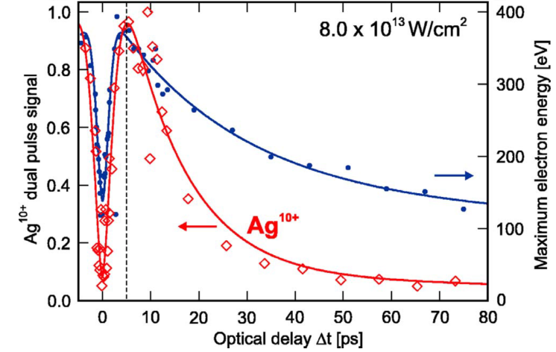
Time dependence
Notes:
So, being femtosecond laser people, the first question that we asked is: “Can we control this plasma formation process with two time-delayed laser pulses”. And, as you can see here, the answer is yes. By using an 800 and 400 nm laser pulses, we are able to create a large enhancement in the total photoion yield then the 400 nm pulse precedes the 800 nm pulse by about 2 to 30 femtoseconds.
This effect has been seen before in nanoscale silver clusters and it was explained very simply. The first pulse creates a nanoplasma which expands. As the nanoplasma expands, it becomes more larger therefore more absorbing of the second laser pulse. However, as the nanoplasma becomes too large, it’s density drops below the critical density and it can no longer effectively absorb energy from the laser pulse.
So, this is a nice result, but we see something even more interesting if we look at the photoion angular distributions that correspond to these red dots.

Slide 9
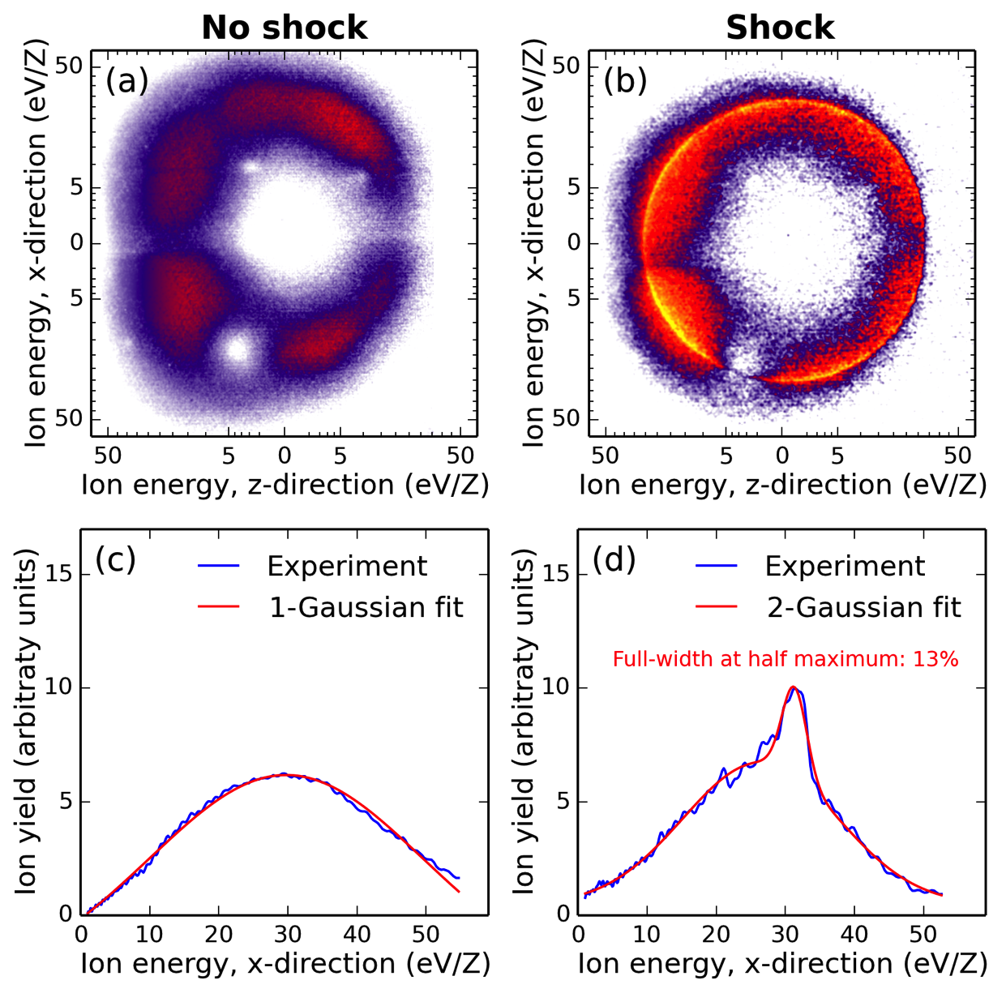
Observation of shock waves
Notes:
This is what the data looks like. If you use a single laser pulse, you generate a big, mostly featureless, blob of ions, shown here. The features that you do see here are due to damage of our MCP detector, so the actual photoion distribution is even more boring.
If we use two laser pulses, we usually still see a big blob of ions. However, if we use two laser pulses with a time delay of about 7 to 40 ps, we start to see some ions distributions that have a sharp peak, that I am going to explain is a shock wave.

Slide 10
Time dependence of shock waves
Notes:
So, looking back at this graph, the red dots correspond to nanoplasmas that produced clear shock waves. You can see that the the appearance and disappearance of the shock waves corresponds very well to the ride and decay of the total photoion yield. So, this indicates that the shock waves are also a result of the nanoplasma expansion process that takes place in the time between the two laser pulses.

Slide 11
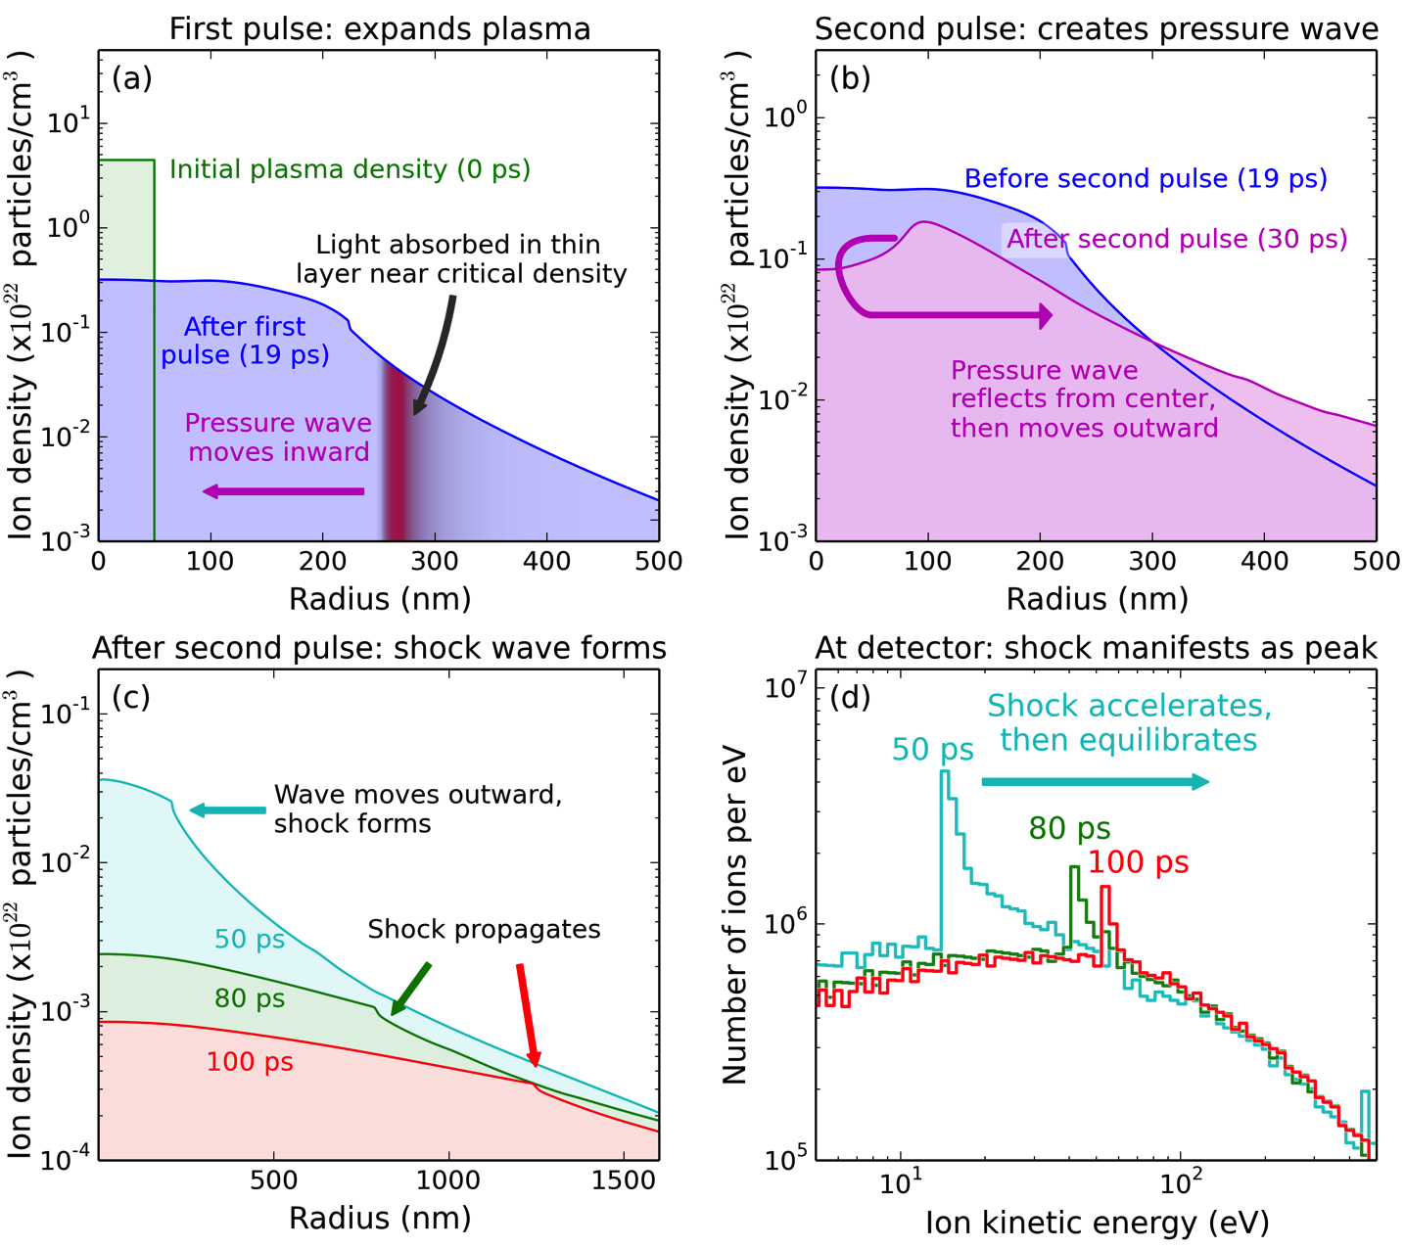
Hydrodynamic simulations
Calculations by Jim Gaffney, LLNL
Notes:
This explanation is supported with hydrodynamic simulations completed by our collaborators at Lawrence Livermore National Lab. This plot has some fun colors, but it’s not a cartoon, it’s the actual results from the numerical simulations.
The first three frames plot the density of the plasma versus the radial coordinate. Immediately after the first laser pulse, the plasma density is just a step function corresponding to the solid density nanoparticle. After about 20 picoseconds, the plasma has expanded and now assumes this smooth decay into the vacuum. Because of this decaying density profile, when the second laser pulse arrives, it is absorbed in a thin layer near the critical density. This localized absorption creates a pressure wave that propagates inwards. The pressure wave reflects from the center and moves outwards. As the pressure wave moves outwards. It steepens into a shock wave. The shock wave may look pretty puny when plotted in the density distribution, but when we look at the kinetic energy distribution of the ions, which is what we actually see on the detector, then the shock wave manifests as an obvious sharp peak, in good agreement with the experiment.

Slide 12
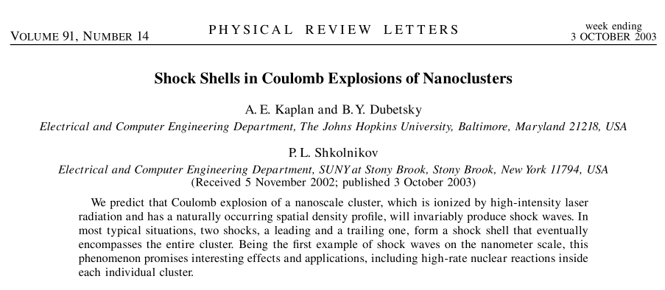
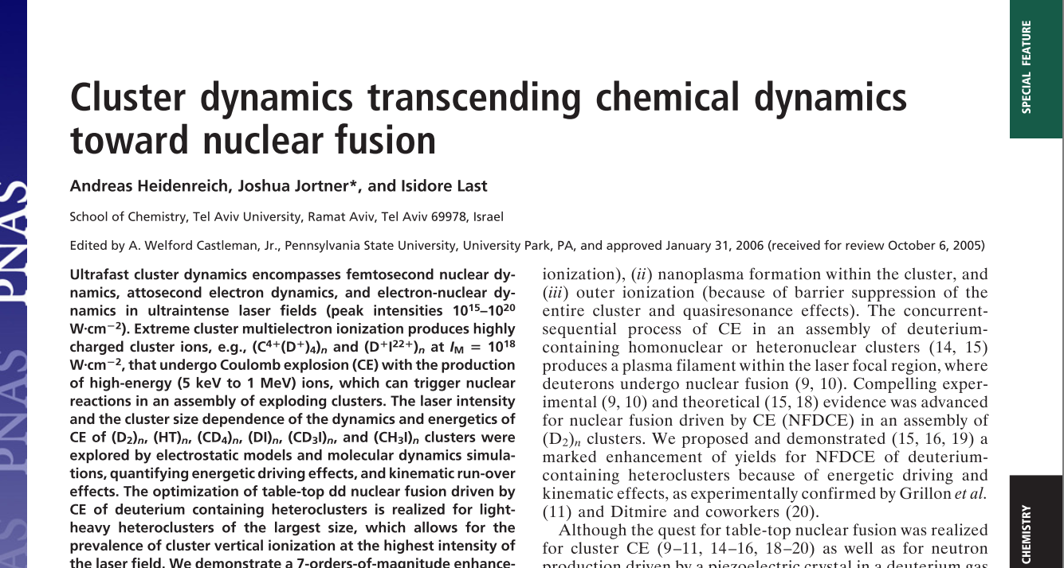
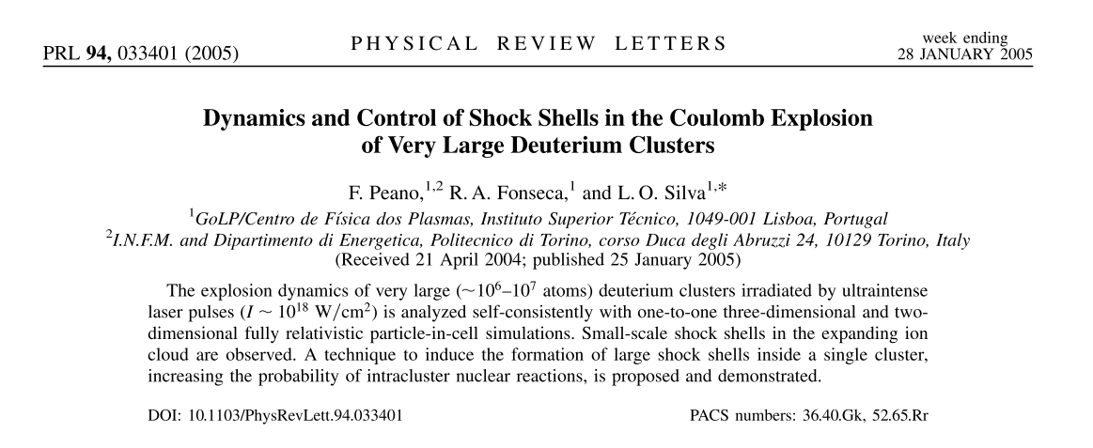
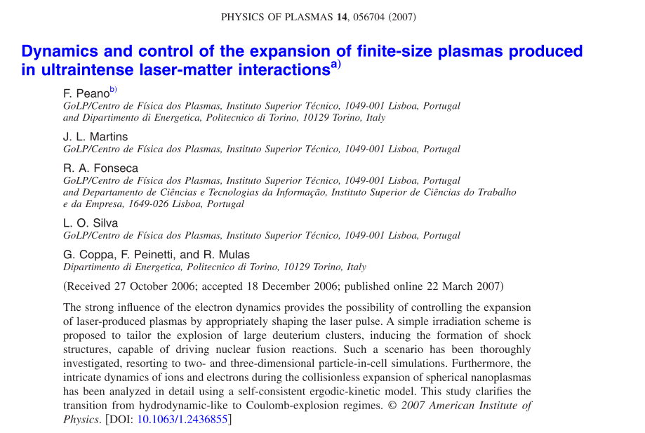
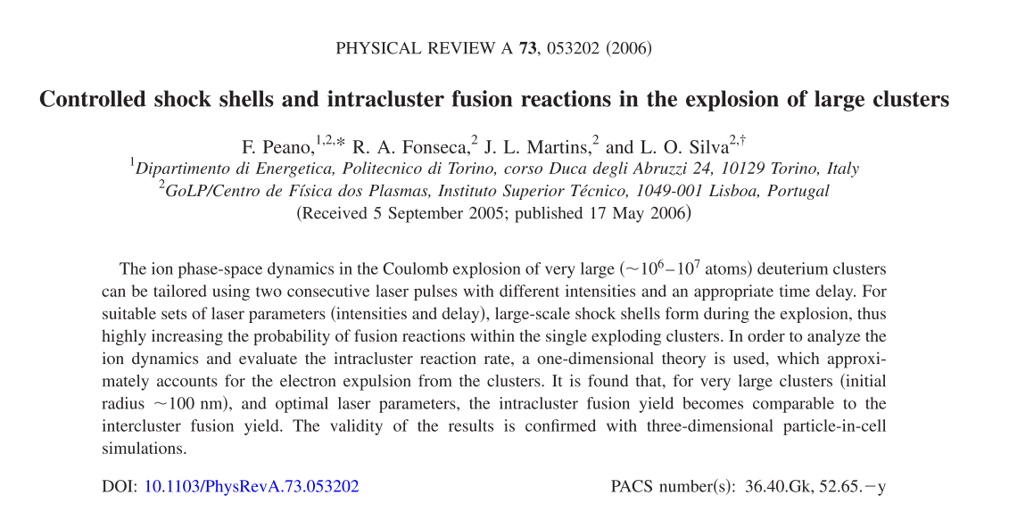
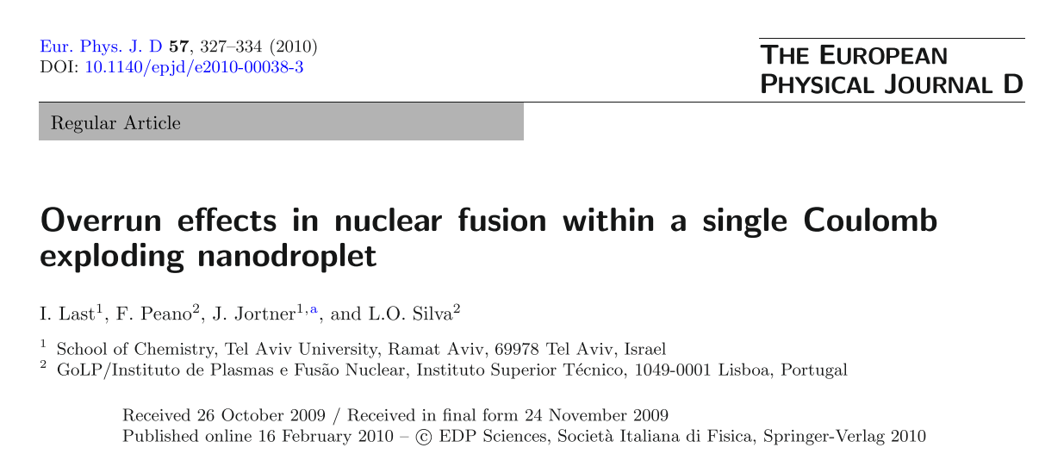
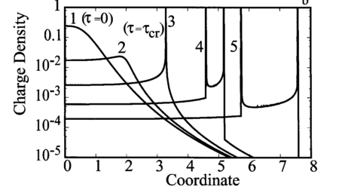
Prediction of nanoplasma shock waves
Notes:
We made this observation of shock waves in nanoplasmas more or less by accident, but actually, shock waves in nanoplasmas had been predicted over a decade ago. First Kaplan and co-workers wrote this paper, and then a lot more followed. So, we hope that by making the first observation of shock waves in nanoplasma, we have opened a new avenue of research, but at the end of the day, we are can at least rest assured that we have brought some glimmer of joy to the theorists by confirming their predictions.

Slide 13
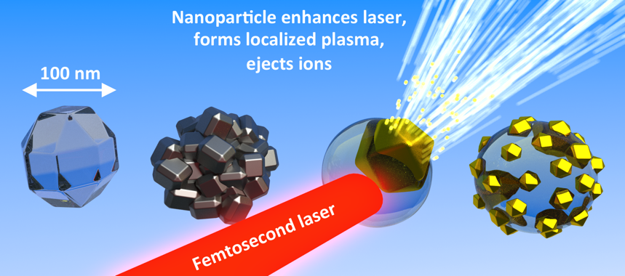
Part 2 Observing localized light absorption in nanoparticles
Notes:
Now I will move on to the second part of this talk, about how we can use the plasma formation process to understand how nanoparticles absorb intense, femtosecond laser pulses. The basic idea is that the laser field is enhanced in a specific region, and a plasma is created only in this region of the nanoparticle. This plasma ejects ions in a specific direction, and this direction corresponds to the location of the plasma within the nanoparticle.

Slide 14
Asymmetry in nanoparticle ion distributions
Laser polarization
Laser propagation
Notes:
If we go back to what the ion distributions look like on the detector, we see that they are often very asymmetric.

Slide 15
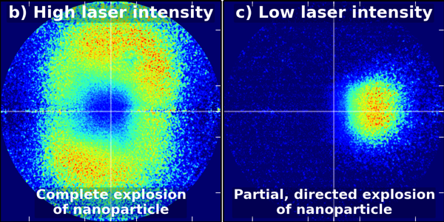
Asymmetry in ion distributions
Depends on laser intensity
Notes:
This asymmetry depends on the intensity of the laser. When the laser intensity is high, we see ion momentum distributions that are more-or-less symmetric about zero kinetic energy and correspond to the creation of a plasma in the entire nanoparticle. However, when we use lower laser intensities, we see ion distributions that are highly asymmetric and correspond to the formation of a localized plasma in a small region of the nanoparticle.

Slide 16
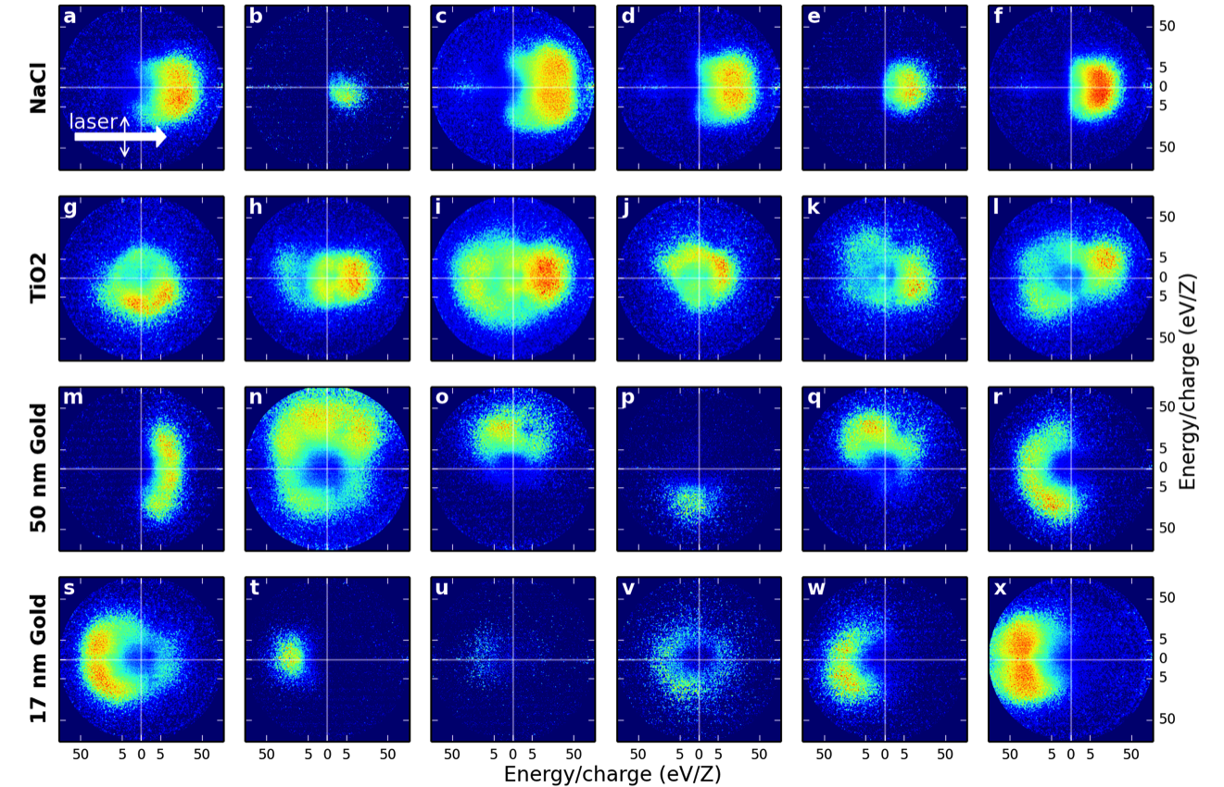
Asymmetric ion distributions
Depends on sample composition
Notes:
We also noticed that the asymmetry of the ion distribution depends on which nanoparticle sample that we use.
a) As you can see, the NaCl sample ejects ions in the direction of laser propagation. This is very unusual for VMI, because the angular distributions are almost always cylindrically symmetric about the laser polarization direction.
b) The TiO2 ejects ions symmetrically about zero kinetic energy. c) 50 nm gold nanoparticles shoot ions in seemingly random directions: up, down, left, right, wherever! D) The 17 nm sample ejects ions back towards the source of the radiation.
But what is causing these different behaviors?

Slide 17
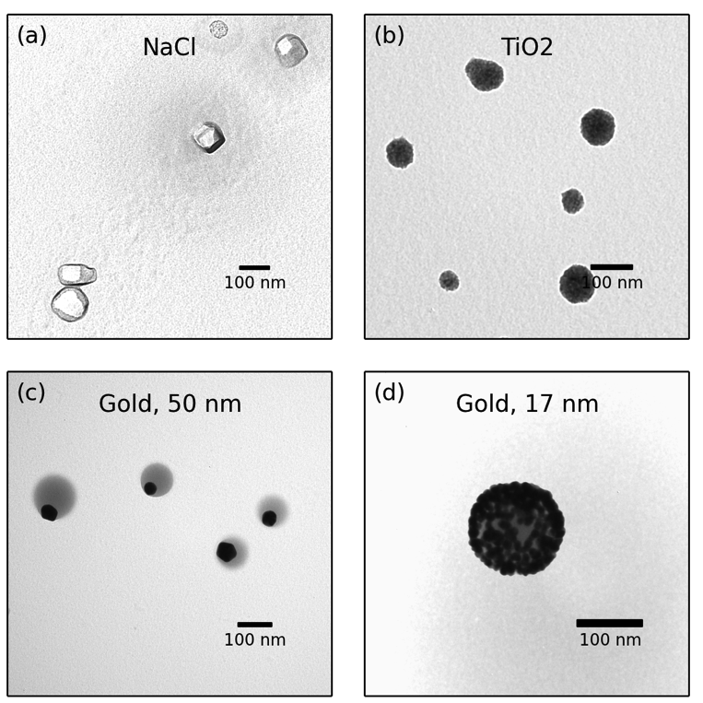
Electron microscopy
Reveals particle morphology
Notes:
The key to figuring out this sample dependence was to place TEM grids inside of the vacuum chamber and collect nanoparticles as they fly through the experiment. Then we can perform electron microscopy and see what are particles actually look like. A) I have already showed you this image, which shows that the sodium chloride solution produces 100 nm particles that appear to be single crystals. B) the TiO2 solution produces aggregates of 5 nm TiO2 particles. C) The 50 nm gold sample produces very weird looking “nano eyeballs” that feature a gold nanoparticle, shown here in black, embedded in a sphere of lower density material. The lower density material is an organic polymer that that manufacturer of the nanoparticles puts in the solution to keep the particles from aggregating, and here it has the unexpected but convenient effect of allowing us to produce asymmetric nanoparticles. D) the 17 nm gold nanoparticle sample is also composed of a large sphere of ligand polymer material, but in this case, we have many small gold nanospheres per aggregate.

Slide 18
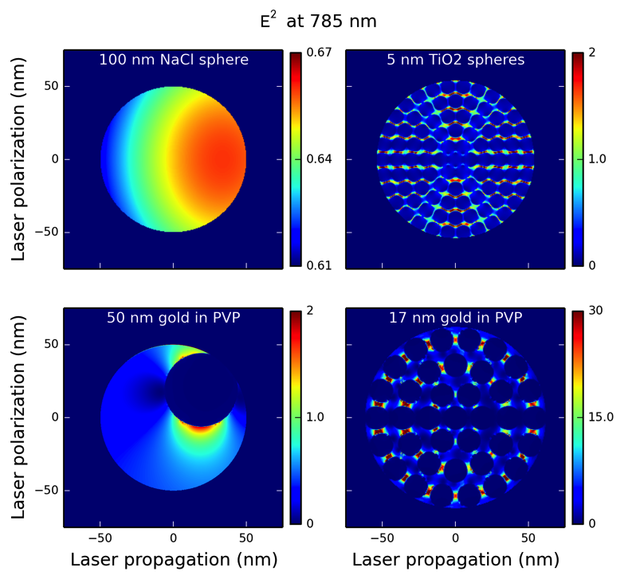
FDTD simulations
Explain light absorption
Notes:
Armed with this information about the morphology of the nanostructures, we used finite-difference time-domain simulations to explain the light absorption behavior of the nanoparticles. In each case, the location of the strongest electric field agrees with the experimentally observed direction of ion ejection. A) for NaCl, the light is enhanced on the backside of the particle, and it seems that the particle is basically acting like a lens and focusing the light onto itself. B) For the TiO2 aggregates, the light is enhanced between the TiO2 particles, but there is not preference for the forward or backward direction. C) For the 50 nm gold nanoparticles, there is not a big effect from the laser polarization or progagation. The electric field is simply strongest near the gold nanoparticle and so a plasma will be formed in this region of the particle preferentially. D) For the 17 nm gold nanoparticles, the field is enhanced by an order of magnitude between the gold nanoparticles. If you look very closely, you can see that the field is higher here on the front side of the particle, in agreement with the experimental results.

Slide 19
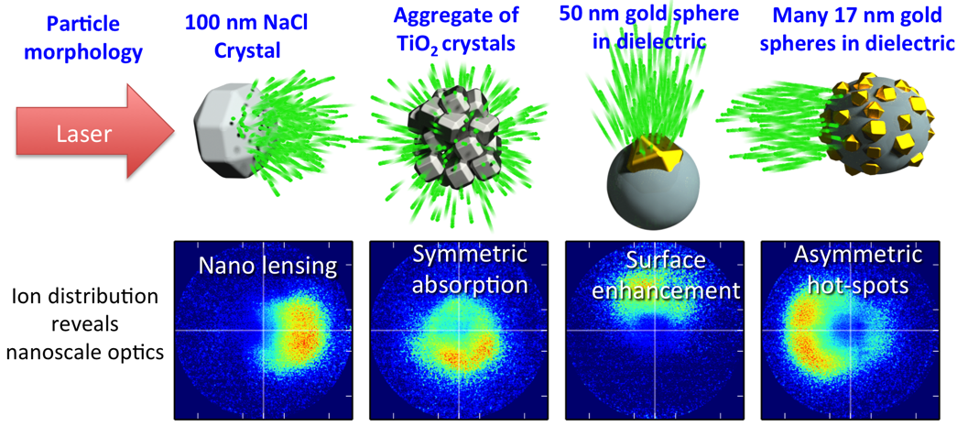
Summary
Ion angular distributions reveal nanoscale optics
Notes:
To summarize this section, we have observed very different ion ejection from these four different nanoparticle samples, and we have explained how the direction of ion ejection is representative of the nano-optical effects in the particles.

Slide 20
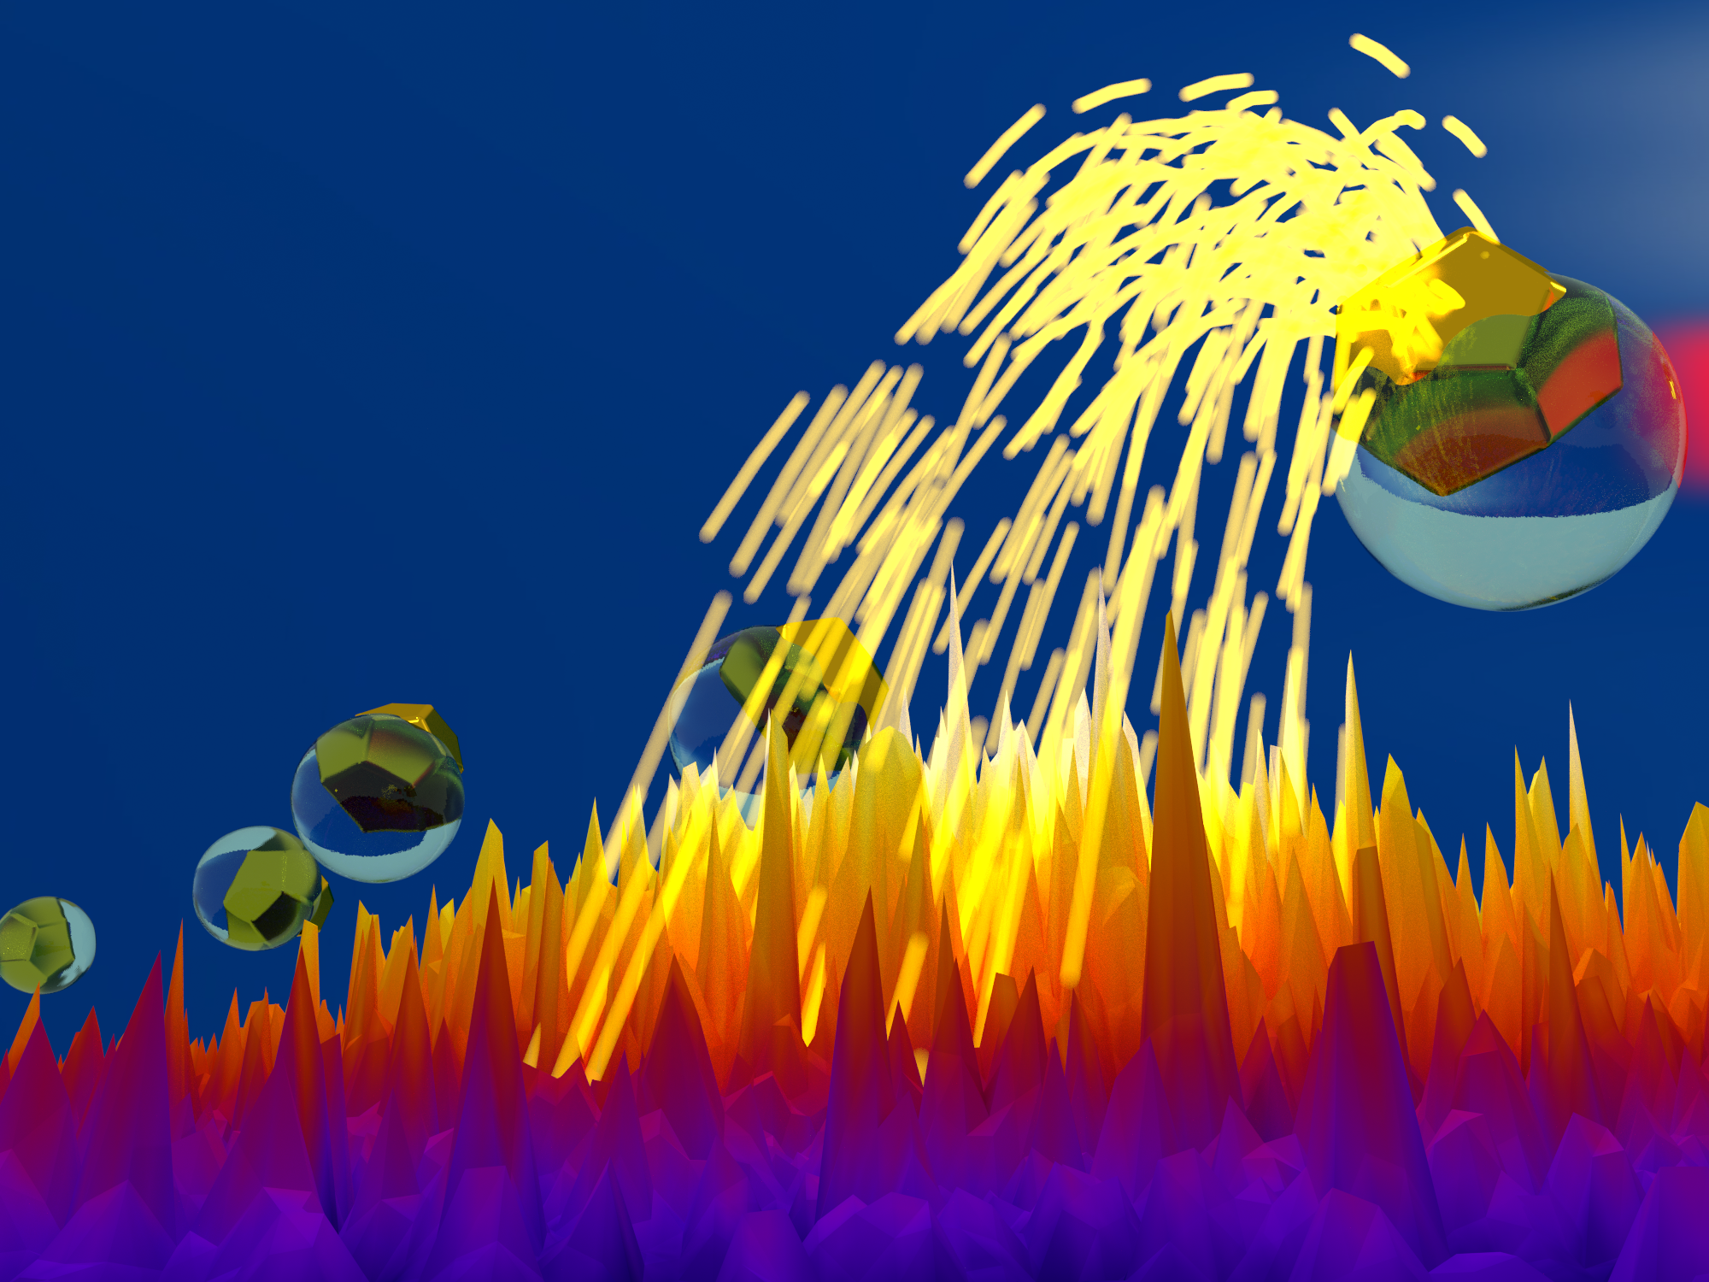
Conclusions and outlook
Experiment
VMI is a versatile tool for nanoscience.
Results
First observation of shock waves in nanoplasmas
Revealed nanoscale optics with localized plasma
Ultrafast charge transfer in quantum dots (poster)
Future directions
Use high-harmonic generation (HHG) source
Generate isolated ~5 nm nanoparticles
Notes:
To conclude the talk, I will emphasize just a few key points. Mainly, what I wanted to show is that, when you combine it with a nanoparticle source, the velocity map imaging spectrometer can be a versatile tool for investigating nanoscale systems. I showed you a few results to support this, demonstrating how we have used a VMI to make the first observation of shock waves in nanoplasmas, reveal nanoscale optical effects via the formation of a localized plasma, and (if you saw the poser on Monday) ultrafast charge transfer between quantum dots and an organic dye molecule.
In the future, we are still venturing onwards on our quest to image the excitonic orbitals of quantum dots, and we hope to achieve this goal incorporating a high-harmonic source into the experiment and improving our particle source to generate smaller and higher-quality nanoparticles.

Slide 21
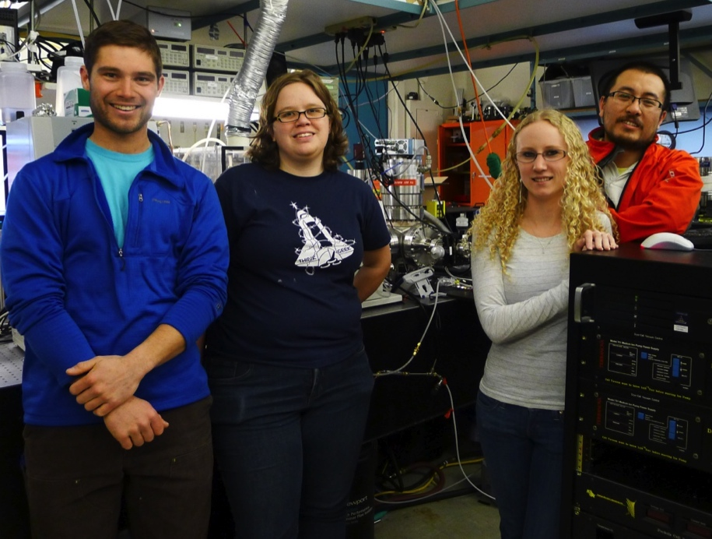



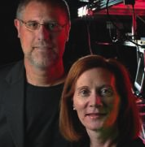

Acknowledgements
JILA
University of Colorado Chemistry Department
Brett Palm
Jose Jimenez
Lawrence Livermore National Lab (LLNL)
Dan
Hickstein
Ellen
Keister
Franklin Dollar
Jennifer
Ellis
Wei
Xiong
Jim Gaffney
Steve Libby
Naval Research Lab (NRL)
Henry Kapteyn
Margaret Murnane
George Petrov
Notes:
To complete these experiments, we needed help from a lot of different, and here is just a partial list of people that I need to thank. Thanks to the team at JILA, especially Jennifer Ellis and Wei Xiong and MARGARET and HENRY. Also thanks to Jose Jimenez and his graduate student Brett Palm. And big thanks to our theory collaborators at Livermore National Lab and Naval Research Lab.

Slide 22

Thank you!
Notes:
So, thank you for your attention, and I would be glad to take any questions or comments.

Slide 23
Thank you!

Slide 24
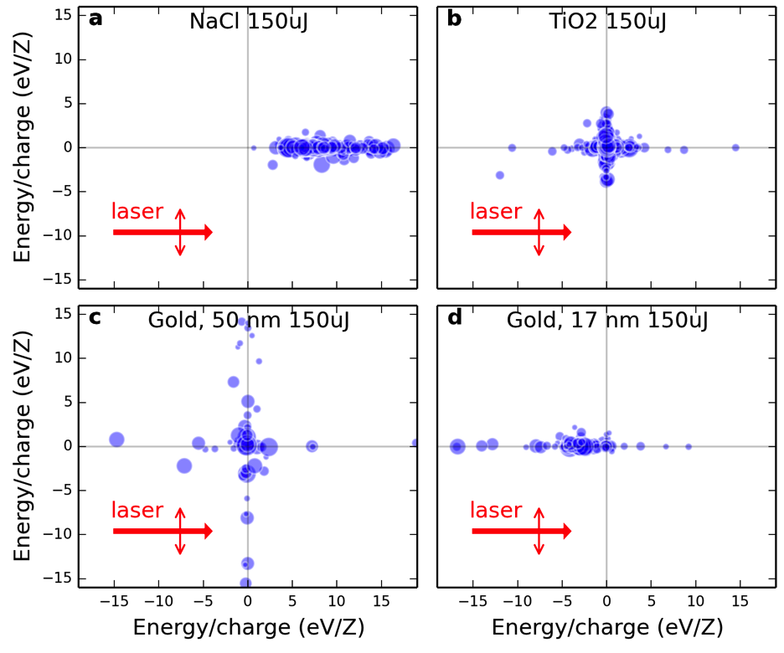
Centers of mass

Slide 25
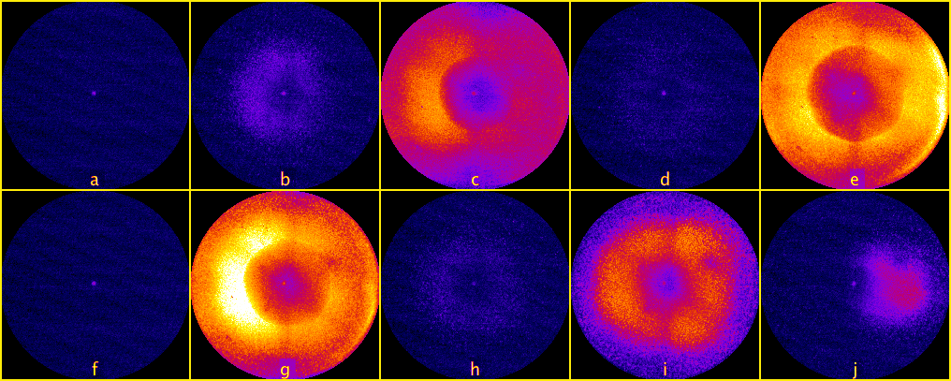
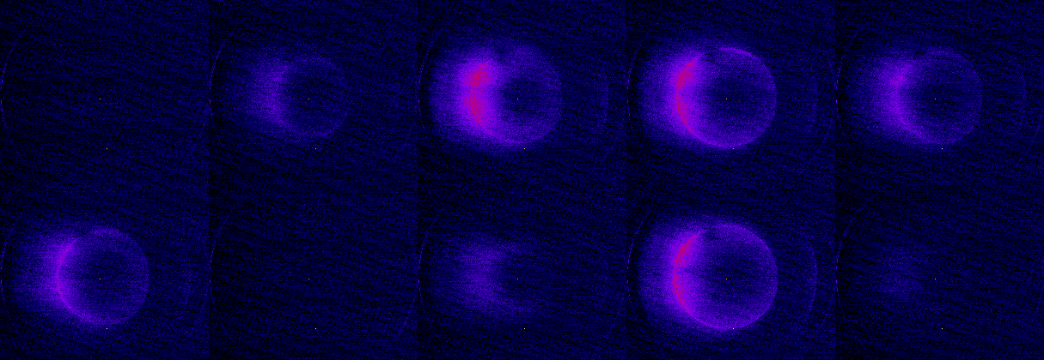
1. Observation of shock waves
One pulse
Two pulses
Notes:
The above are the raw photoion momentum distributions from nanoplasma explosions of single nanoparticles with diameters between ~40 nm and 100 nm with an 800 nm laser. The center of the frame corresponds to ions with zero kinetic energy while the edge of the frame is 80 eV. The laser polarization is in the vertical direction and the laser propagates from left to right. Frames a and f show no particles, while frames b, d, h, I, and j show diffuse plasma explosions. Frames c, e, and g, display shock shells¹ (indicated with arrows) that were generated from particles subjected to the precise laser intensity required to initiate the shock physics. ¹Kaplan, Dubetsky, Shkolnikov, Phys. Rev. Lett. 91, 143401 (2003)

Slide 26
One pulse animation
Notes:
But occasionally we see a flash corresponding to the ions created from a single laser-irradiated nanoparticle. The edge of the frame is about 100 eV, so as you can see, we are producing a big blob of ions all the way past 100 eV.

Slide 27
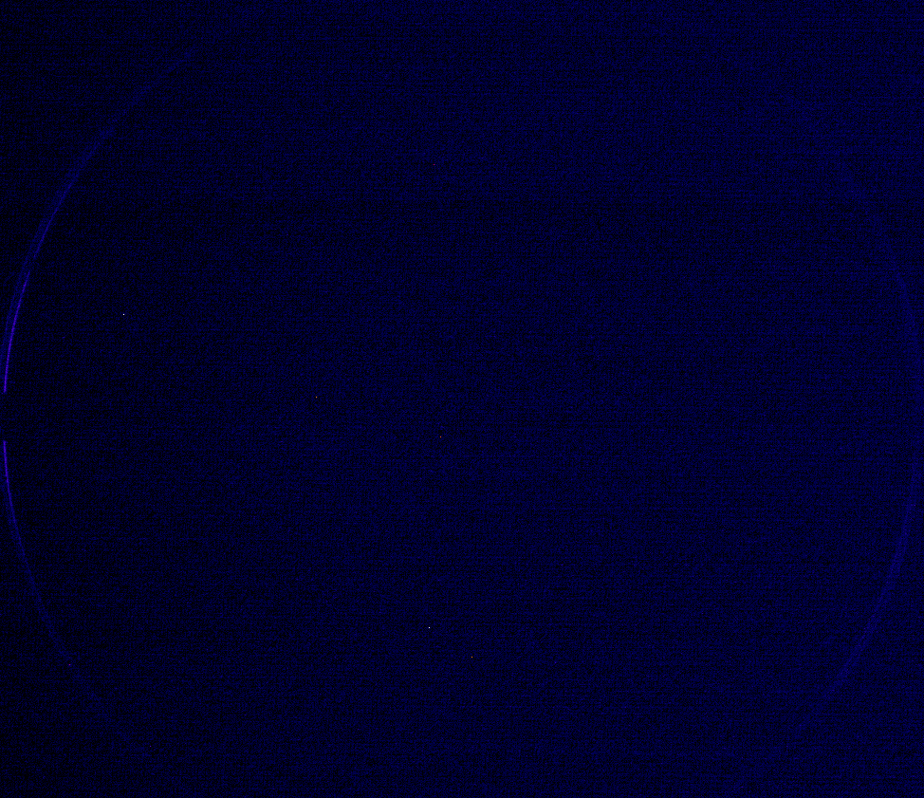
Two-pulse animation

Slide 28
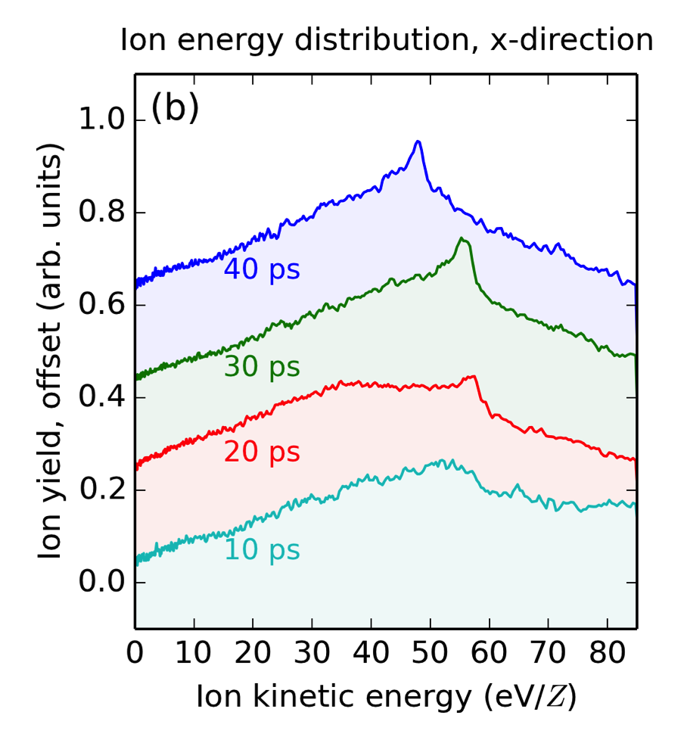
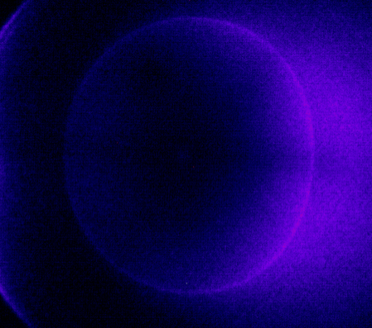
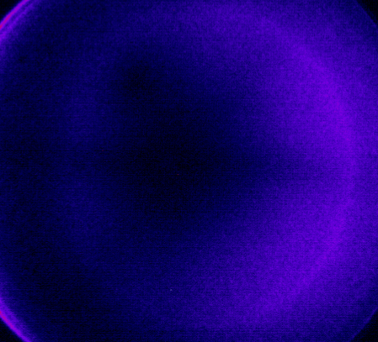
Time dependence of shock waves
40 ps
10 ps
Notes:
One last point that I would like to make is this. The shock waves look qualitatively different at different time delays. As you can see, the shock at 10 ps looks much less sharp than the shock at 40 ps. If you look at the 1D lineouts, you can see that the shock at 40 ps is indeed much sharper and contains a larger fraction of the ions than the shock at 10 ps. This same effect is seen in the simulations. So, this demonstrates that we have some rudimentary level of control over the shock waves. In the future, we think that it could be possible to use additional laser pulses to shape the plasma density profile to further enhance the shock wave formation.

Slide 29
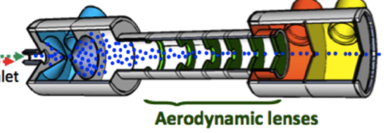
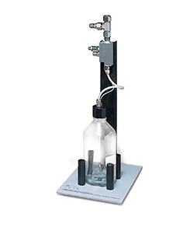
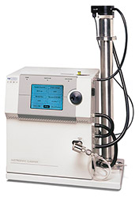
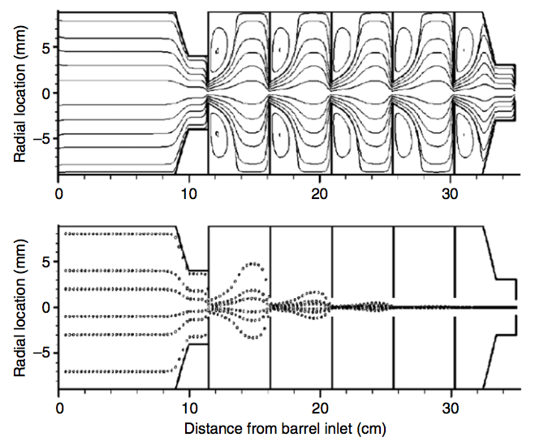
Particle generation
Atomizer generates broad particle distribution centered around 50 nm diameter
Electrostatic classifier and DMA (Differential Mobility Analyzer) select particles of a specific size range.
Aerodynamic lens focuses particles into collimated beam

Slide 30
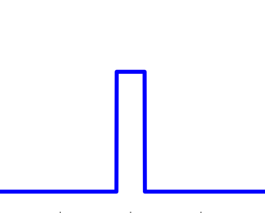
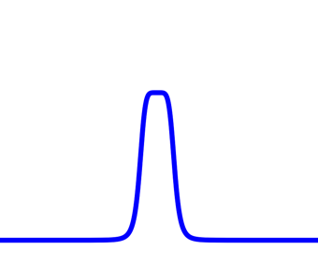
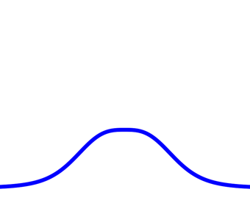

Shock waves with two pulses
2. Plasma slowly expands, assuming the smooth density profile crucial for shock production
1. Pump pulse turns nanoparticle into plasma
3. Pump pulse rapidly explodes the plasma
4. Shock shell forms in rapidly expanding plasma
Density profile
Density profile
Density profile
Density profile
Time (picosecond timescale)
Notes:
This allows us to make the following qualitative picture of what is going on. The first pulse creates a plasma. This plasma then expands. The amount of expansion depends on the time delay before the second laser pulse. When the second laser pulse arrives and dumps more energy into the plasma. Then, a shock forms in the expanding plasma.

Slide 31





Size selected nanoparticles
60 nm
80 nm
100 nm
120 nm
140 nm*
*Recorded with lower MCP setting

Slide 32

Size selected nanoparticles

Slide 33
Comparison to previous experiments
Experimental parameter | Previous experiments | This experiment
Particle composition | Condensed gases (Xe, Ar, D₂) | Solids (NaCl, NH₄NO₃, gold)
Nanoplasma diameter | 5 nm | 100 nm
Number of atoms | 10³ to 10⁴ | 10⁷
Plasma temperature | keV | eV
Expansion timescale | 10⁻¹⁴ sec | 10⁻¹¹ sec
Nanoplasmas per laser pulse | >10⁴ | <1
Notes:
So, how did we observe shock waves in nanoplasma when so many other experiments had failed to do so? Well, we cheated!
The theory papers had predicted shock waves in the regime of small noble-gas clusters. Our experiment operates in a completely different regime, where we use much larger solid nanoparticles that contain several orders of magnitude more atoms. Most importantly, we look at just one nanoparticle per laser shot. Because our nanoparticles are so much larger than previous studies, we can collect enough ions even from a single nanoparticle.
So, how does the experiment work?

